Slide 1
Exploring Quantum Computing in Particle Physics
Alex McCarron

Slide 2
Goal:
Determine whether Hamiltonian Truncation Effective Theory can reduce digitisation errors and/or qubit requirements compared to basic JLP and HO basis methods in 0+1D scalar field theory

Slide 3
Quantum Computing
1

Slide 4
Quantum Computing
1
Why?
Fundamental computational limits
Many body quantum systems
Emergence of NISQ Era hardware

Slide 5
Quantum Computing
1
Why?
Fundamental computational limits
Many body quantum systems
Emergence of NISQ Era hardware
Qubits:
A quantum two-level system: ∣ψ⟩=α∣0⟩+β∣1⟩
Information stored in probability amplitudes
For n qubits our working Hilbert Space Dimension is 2^{n} = n_{Φ}

Slide 6
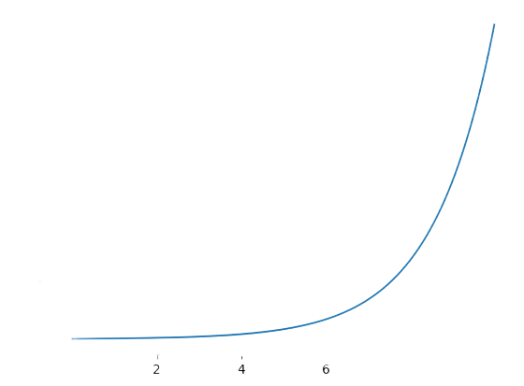
Quantum Computing
1
Why?
Fundamental computational limits
Many body quantum systems
Emergence of NISQ Era hardware
Qubits:
A quantum two-level system: ∣ψ⟩=α∣0⟩+β∣1⟩
Information stored in probability amplitudes
For n qubits our working Hilbert Space Dimension is 2^{n} = n_{Φ}
dim(H)
n Qubits

Slide 7
What we’re going to look at
2
How do we simulate Quantum Field Theories on Quantum Computers?
Digitisation Methods - What does digitisation mean? What are they?
JLP Digitisation
Harmonic Oscillator Digitisation
How do they compare? How does this relate to Qubit usage?
Improving Digitisation Methods? - Can it be done?
Hamiltonian Truncation Effective Theory (HTET)
Does it improve errors?
Does it decrease the number of Qubits we need?

Slide 8
Q: What do we do when we want to Simulate an infinitely spanning continuous Quantum Field Theory on a finite Qubit System?
3

Slide 9
Q: What do we do when we want to Simulate an infinitely spanning continuous Quantum Field Theory on a finite Qubit System?
3
A: Digitisation

Slide 10
Q: What do we do when we want to Simulate an infinitely spanning continuous Quantum Field Theory on a finite Qubit System?
3
A: Digitisation
Truncation + Discretisation
We set a maximum and minimum value
We split a continuous field into finite parts

Slide 11
Q: What do we do when we want to Simulate an infinitely spanning continuous Quantum Field Theory on a finite Qubit System?
3
A: Digitisation
Truncation + Discretisation
We set a maximum and minimum value
We split a continuous field into finite parts
ERRORS

Slide 12
Digitisation - How does it work?
4

Slide 13
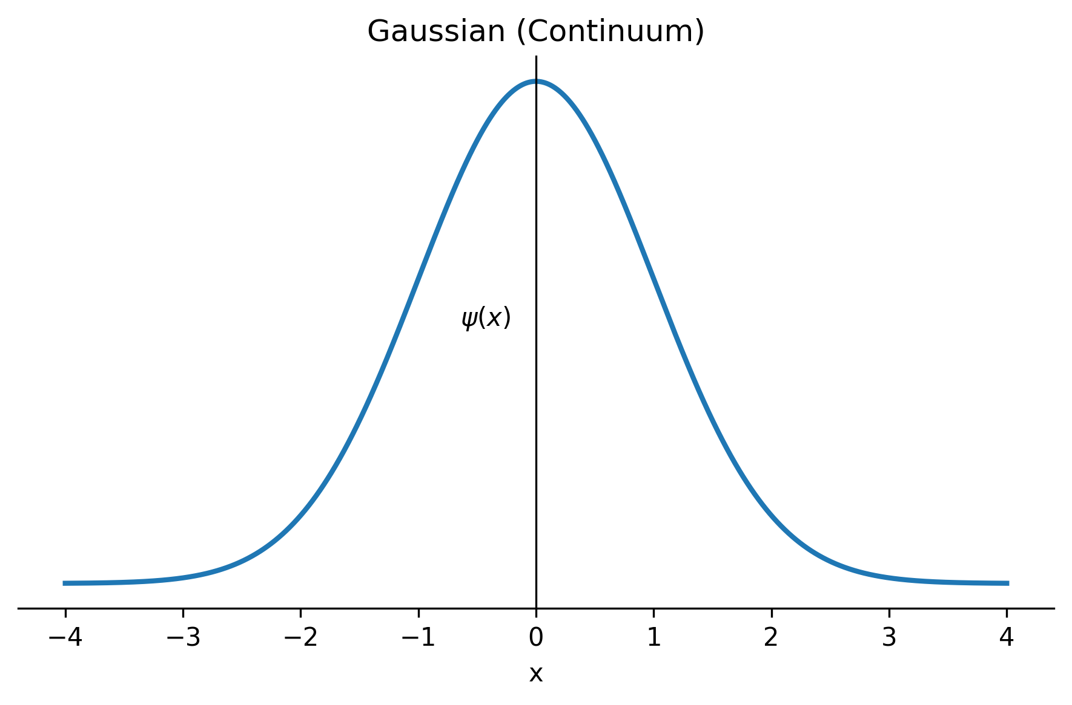
Digitisation - How does it work?
4

Slide 14
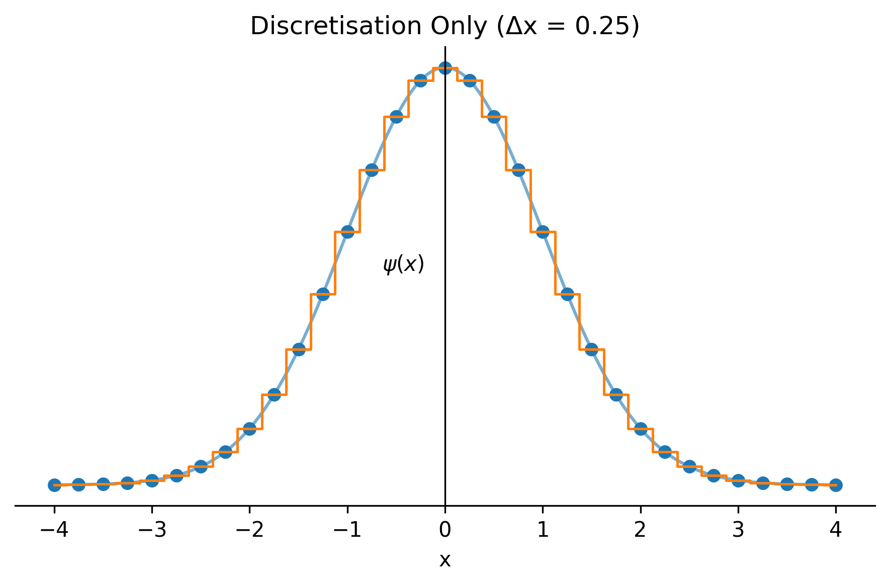
Digitisation - How does it work?
4

Slide 15
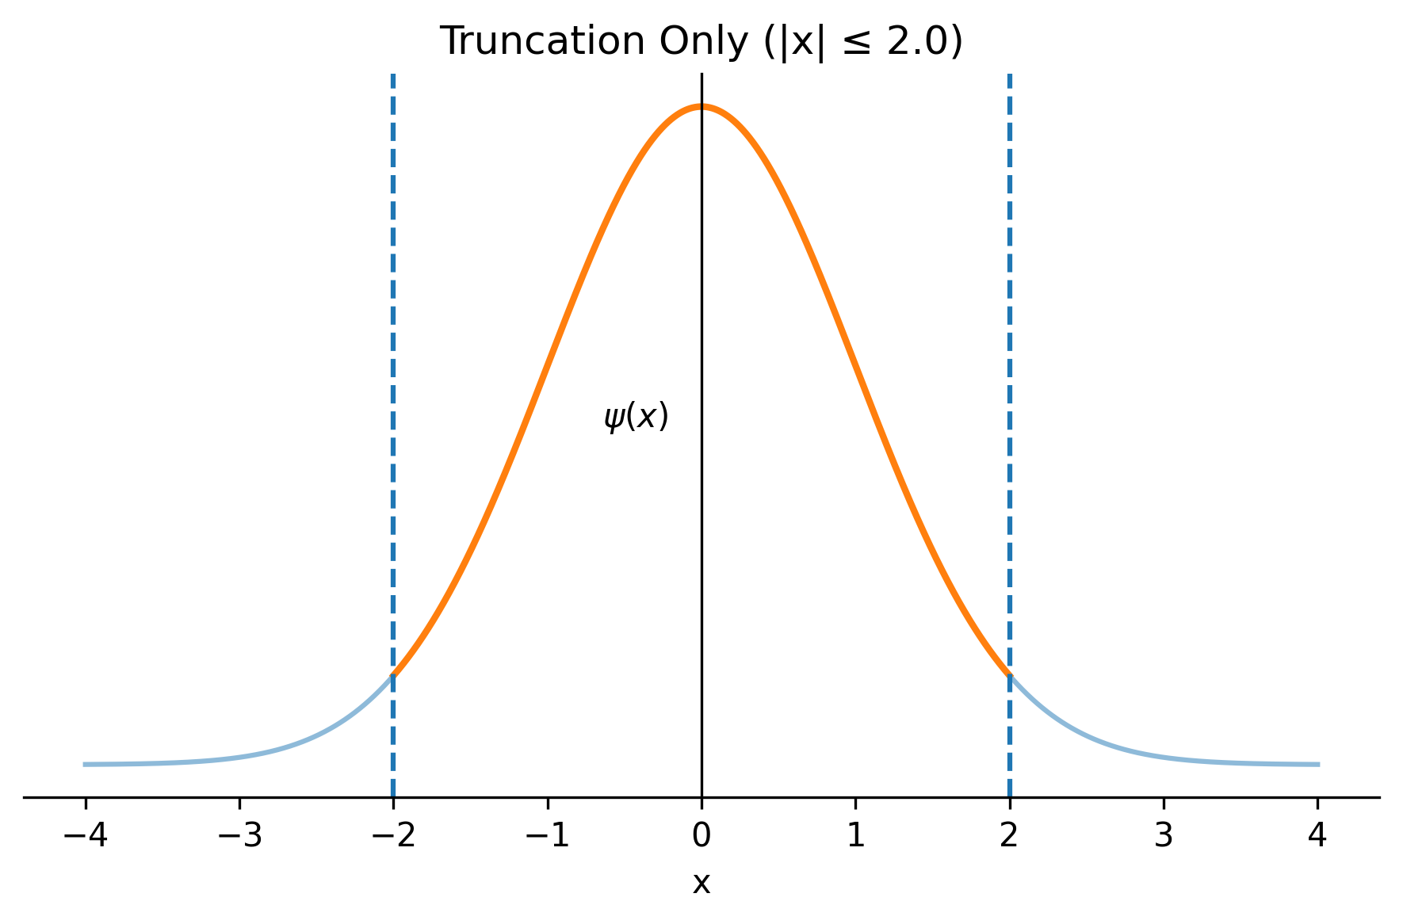
Digitisation - How does it work?
4

Slide 16
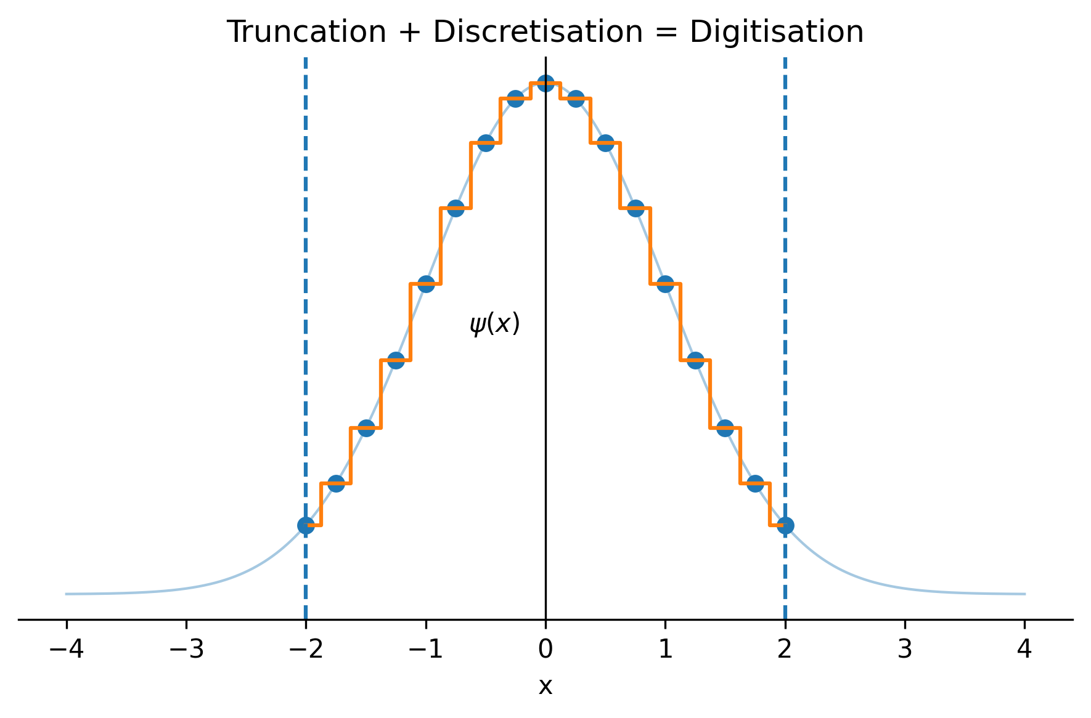
Digitisation - How does it work?
4

Slide 17
Digitisation - JLP_{[1]}
5
[1] - N. Klco and M. J. Savage, Digitization of scalar fields for quantum computing, Physical Review A
99, 10.1103/physreva.99.052335 (2019).

Slide 18
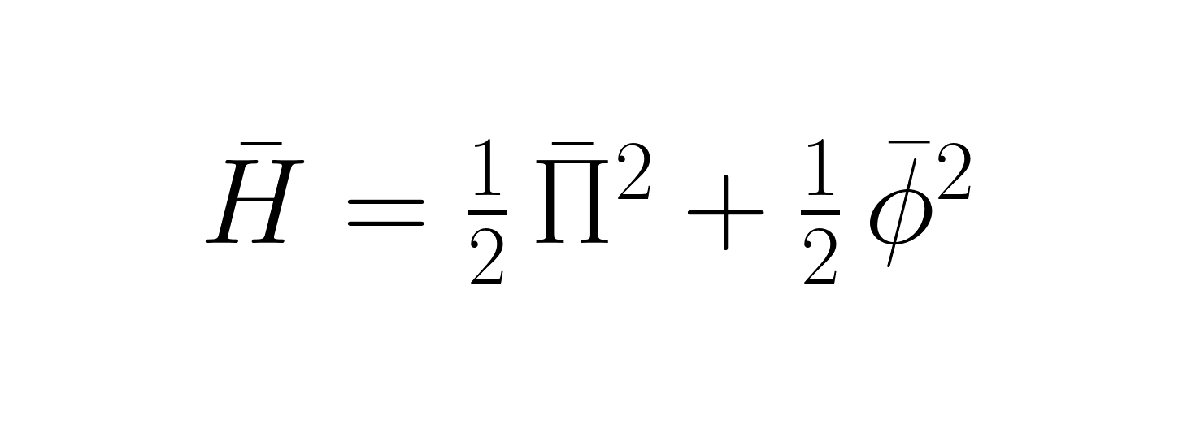
Digitisation - JLP_{[1]}
5
(0+1D Quantum Mechanics)
[1] - N. Klco and M. J. Savage, Digitization of scalar fields for quantum computing, Physical Review A
99, 10.1103/physreva.99.052335 (2019).

Slide 19
Digitisation - JLP_{[1]}
5
Energy Eigenvalues - Compare against known values
(0+1D Quantum Mechanics)
[1] - N. Klco and M. J. Savage, Digitization of scalar fields for quantum computing, Physical Review A
99, 10.1103/physreva.99.052335 (2019).

Slide 20
Digitisation - JLP_{[1]}
5
Energy Eigenvalues - Compare against known values
+
Kinetic Term
Potential Term
Both are fields
[1] - N. Klco and M. J. Savage, Digitization of scalar fields for quantum computing, Physical Review A
99, 10.1103/physreva.99.052335 (2019).

Slide 21
Digitisation - JLP_{[1]}
5
Energy Eigenvalues - Compare against known values
+
Kinetic Term
Potential Term
Digitise Both
Both are fields
[1] - N. Klco and M. J. Savage, Digitization of scalar fields for quantum computing, Physical Review A
99, 10.1103/physreva.99.052335 (2019).

Slide 22
Digitisation - JLP_{[1]}
5
Energy Eigenvalues - Compare against known values
+
Kinetic Term
Potential Term
Digitise Both
Both are fields
Explicitly calculating as a matrix
[1] - N. Klco and M. J. Savage, Digitization of scalar fields for quantum computing, Physical Review A
99, 10.1103/physreva.99.052335 (2019).

Slide 23

Digitisation - JLP_{[1]}
6
Kinetic Term
Potential Term
[1] - N. Klco and M. J. Savage, Digitization of scalar fields for quantum computing, Physical Review A
99, 10.1103/physreva.99.052335 (2019).

Slide 24
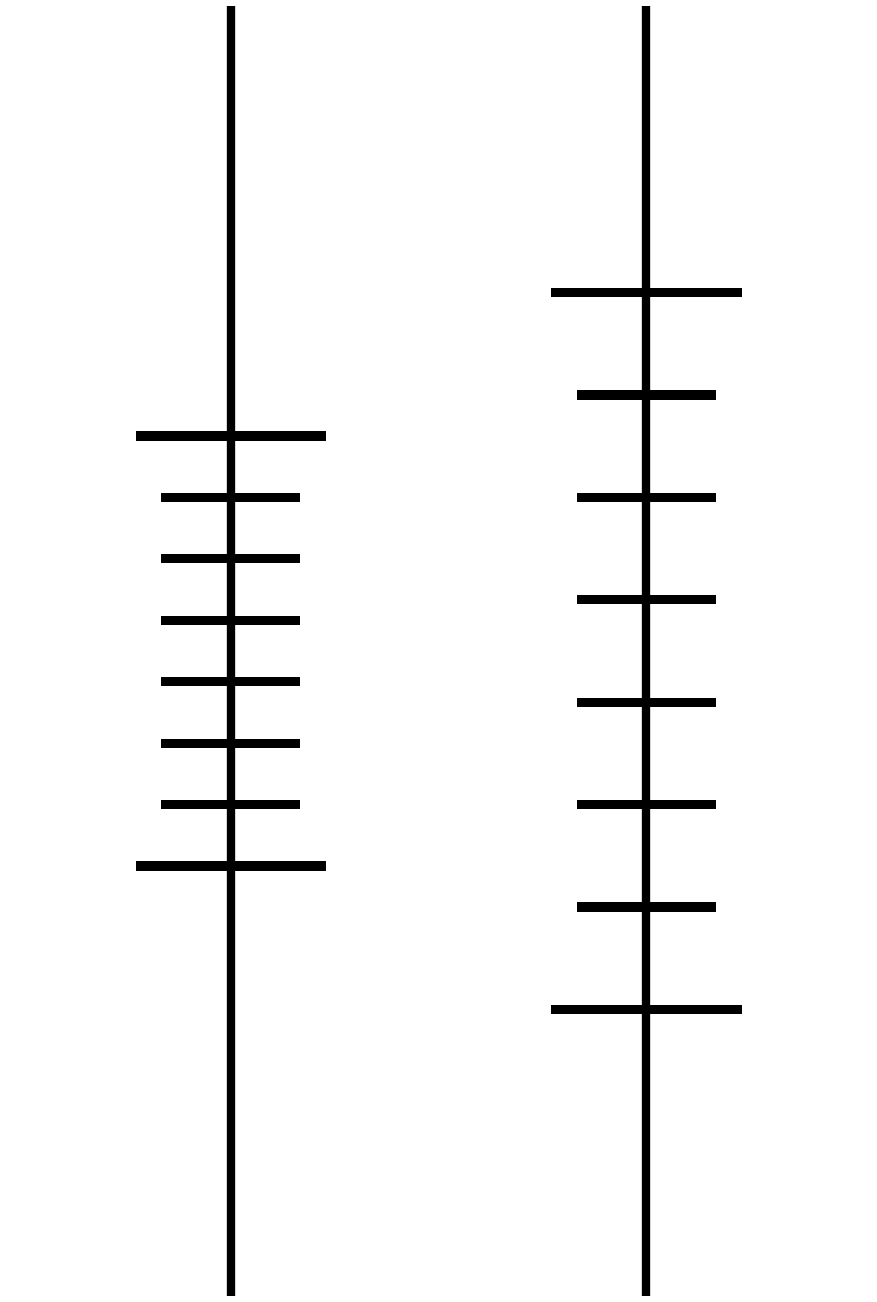
Digitisation - JLP_{[1]}
6
Kinetic Term
Potential Term
Φ_{max}
k_{max}
-k_{max}
-Φ_{max}
[1] - N. Klco and M. J. Savage, Digitization of scalar fields for quantum computing, Physical Review A
99, 10.1103/physreva.99.052335 (2019).

Slide 25
Digitisation - JLP_{[1]}
6
Kinetic Term
Potential Term
Φ_{max}
k_{max}
Matrix Construction
Diagonal Elements set to values of k and Φ
-k_{max}
-Φ_{max}
[1] - N. Klco and M. J. Savage, Digitization of scalar fields for quantum computing, Physical Review A
99, 10.1103/physreva.99.052335 (2019).

Slide 26
Digitisation - JLP_{[1]}
6
Kinetic Term
Potential Term
Φ_{max}
k_{max}
Matrix Construction
Diagonal Elements set to values of k and Φ
matrix converted to field space using a quantum fourier transform
-k_{max}
-Φ_{max}
[1] - N. Klco and M. J. Savage, Digitization of scalar fields for quantum computing, Physical Review A
99, 10.1103/physreva.99.052335 (2019).

Slide 27
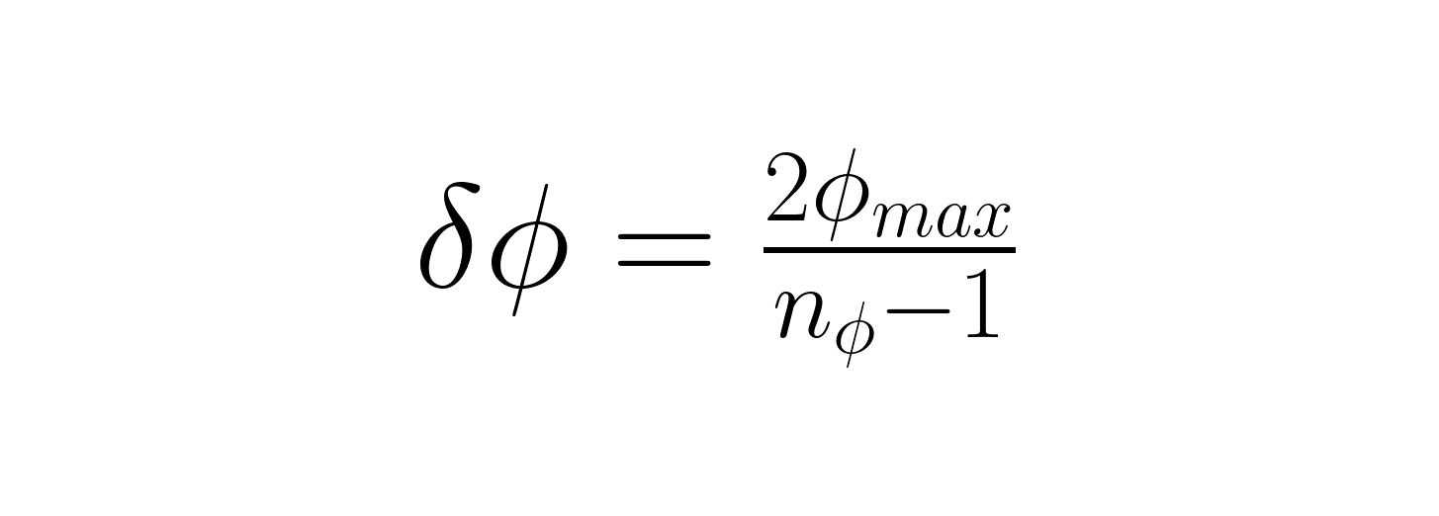
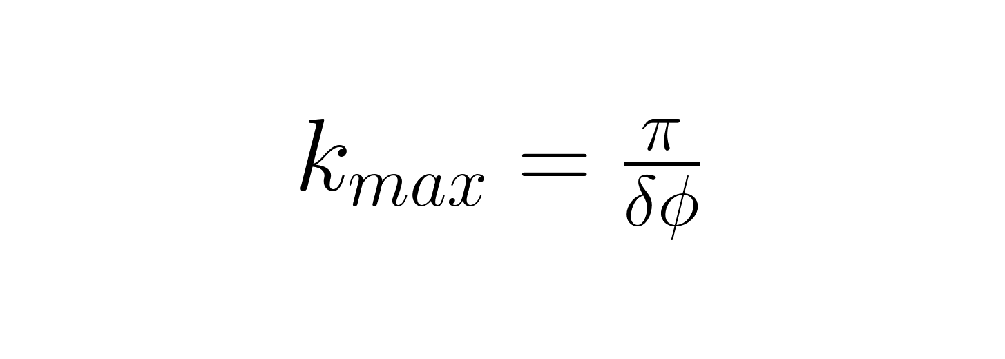
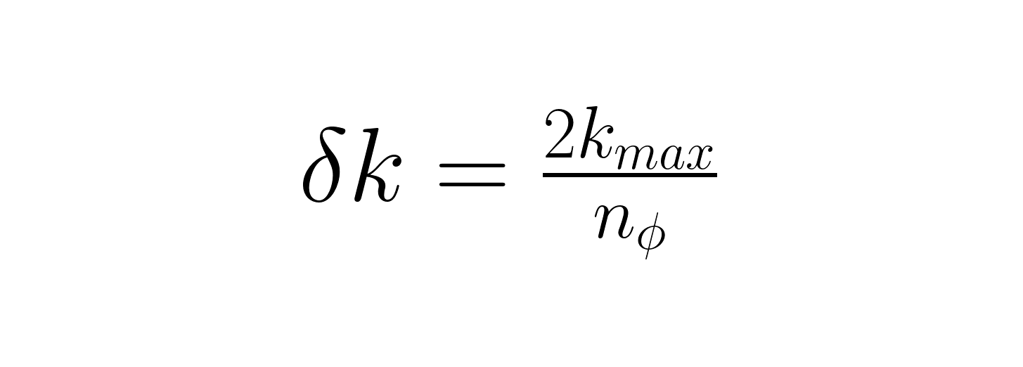
Digitisation - JLP_{[1]}
6
Kinetic Term
Potential Term
Φ_{max}
k_{max}
Matrix Construction
Diagonal Elements set to values of k and Φ
matrix converted to field space using a quantum fourier transform
-k_{max}
-Φ_{max}
[1] - N. Klco and M. J. Savage, Digitization of scalar fields for quantum computing, Physical Review A
99, 10.1103/physreva.99.052335 (2019).

Slide 28
Digitisation - JLP_{[1]}
6
Kinetic Term
Potential Term
Matrix Construction
Diagonal Elements set to values of k and Φ
matrix converted to field space using a quantum fourier transform
[1] - N. Klco and M. J. Savage, Digitization of scalar fields for quantum computing, Physical Review A
99, 10.1103/physreva.99.052335 (2019).

Slide 29
Digitisation - JLP
Digitisation - JLP_{[1]}
7
[1] - N. Klco and M. J. Savage, Digitization of scalar fields for quantum computing, Physical Review A
99, 10.1103/physreva.99.052335 (2019).

Slide 30
Digitisation - JLP_{[1]}
7
Nyquist Shannon Sampling Theorem:
Balance contributions from both the kinetic and potential terms
[1] - N. Klco and M. J. Savage, Digitization of scalar fields for quantum computing, Physical Review A
99, 10.1103/physreva.99.052335 (2019).

Slide 31
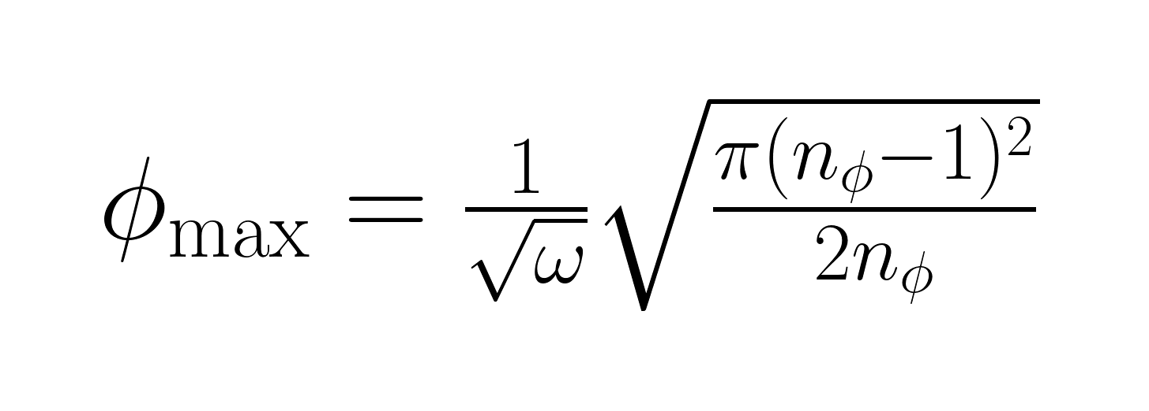

Digitisation - JLP_{[1]}
7
Nyquist Shannon Sampling Theorem:
Balance contributions from both the kinetic and potential terms
[4]
[1] - N. Klco and M. J. Savage, Digitization of scalar fields for quantum computing, Physical Review A
99, 10.1103/physreva.99.052335 (2019).
[4] - C. W. Bauer, B. Nachman, and M. Freytsis, Simulating collider physics on quantum computers using
effective field theories, Physical Review Letters 127, 10.1103/physrevlett.127.212001 (2021).

Slide 32
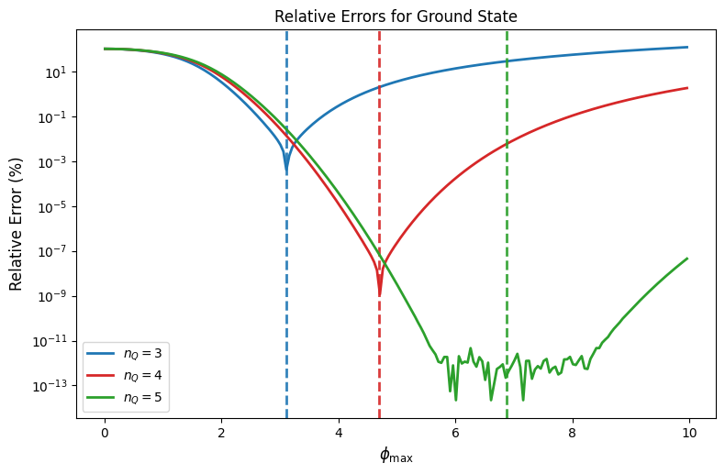
Digitisation - JLP
Digitisation - JLP_{[1]}
8
Dotted lines are calculated optimal ϕ_{max} values
Decreased errors for increased Qubit number
Direct reproduction of results seen in literature _{[1]}
[1] - N. Klco and M. J. Savage, Digitization of scalar fields for quantum computing, Physical Review A
99, 10.1103/physreva.99.052335 (2019).

Slide 33
Digitisation - Harmonic Oscillator Basis _{[1]}
9
[1] - N. Klco and M. J. Savage, Digitization of scalar fields for quantum computing, Physical Review A
99, 10.1103/physreva.99.052335 (2019).

Slide 34
Digitisation - Harmonic Oscillator Basis _{[1]}
9
Digitise a set of harmonic oscillator energy eigenstates instead of the field and momentum spaces directly
[1] - N. Klco and M. J. Savage, Digitization of scalar fields for quantum computing, Physical Review A
99, 10.1103/physreva.99.052335 (2019).

Slide 35
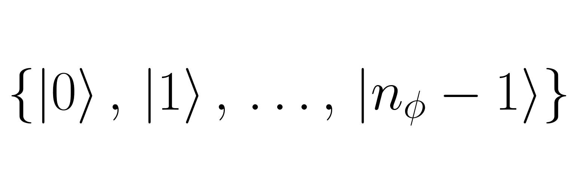
Digitisation - Harmonic Oscillator Basis _{[1]}
9
Digitise a set of harmonic oscillator energy eigenstates instead of the Field and Momentum spaces directly
[1] - N. Klco and M. J. Savage, Digitization of scalar fields for quantum computing, Physical Review A
99, 10.1103/physreva.99.052335 (2019).

Slide 36
Digitisation - Harmonic Oscillator Basis _{[1]}
9
Digitise a set of harmonic oscillator energy eigenstates instead of the Field and Momentum spaces directly
How do we express and in terms of these states?
[1] - N. Klco and M. J. Savage, Digitization of scalar fields for quantum computing, Physical Review A
99, 10.1103/physreva.99.052335 (2019).

Slide 37
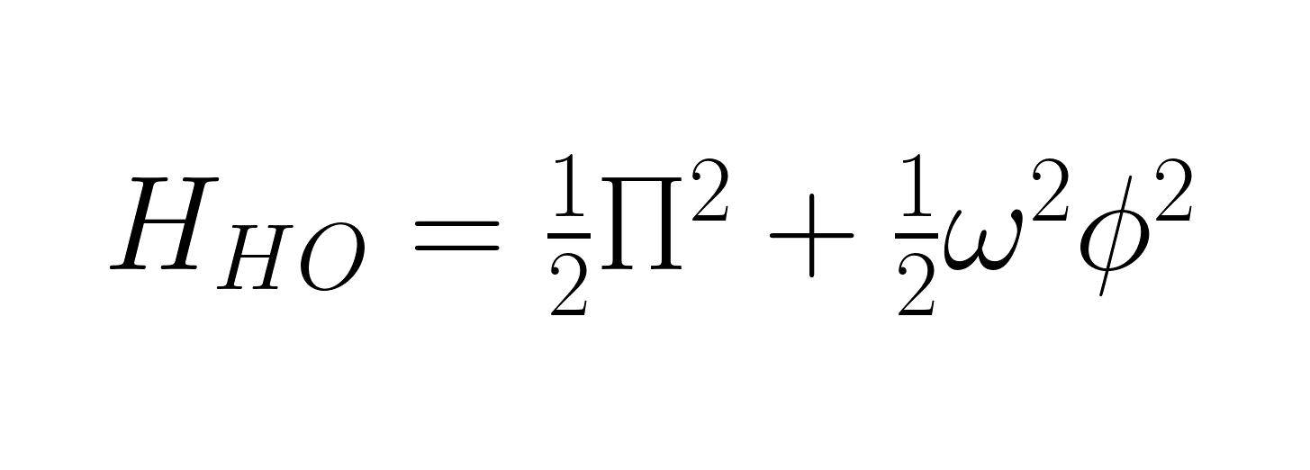
Digitisation - Harmonic Oscillator Basis _{[1]}
10
[1] - N. Klco and M. J. Savage, Digitization of scalar fields for quantum computing, Physical Review A
99, 10.1103/physreva.99.052335 (2019).

Slide 38
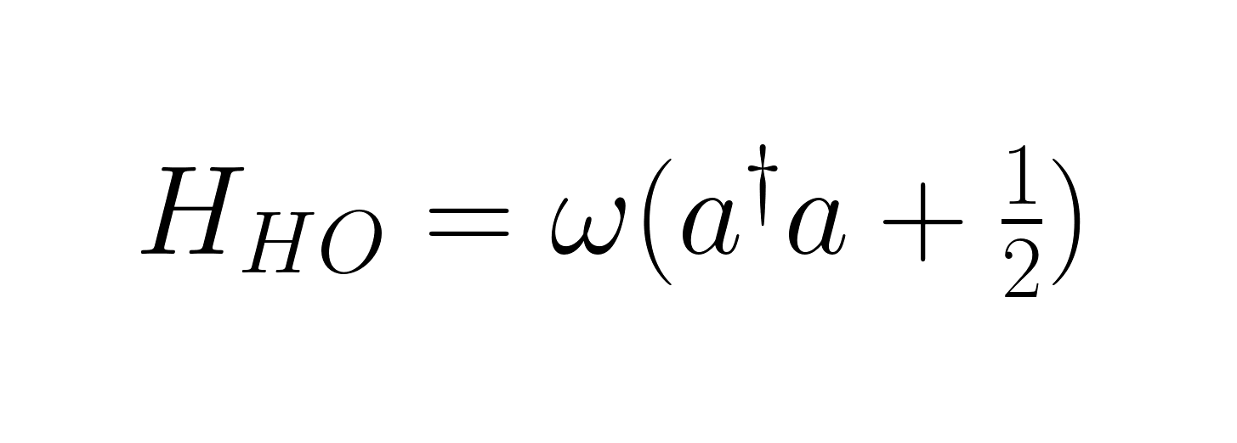
Digitisation - Harmonic Oscillator Basis _{[1]}
10
[1] - N. Klco and M. J. Savage, Digitization of scalar fields for quantum computing, Physical Review A
99, 10.1103/physreva.99.052335 (2019).

Slide 39
Digitisation - Harmonic Oscillator Basis _{[1]}
10
&
[1] - N. Klco and M. J. Savage, Digitization of scalar fields for quantum computing, Physical Review A
99, 10.1103/physreva.99.052335 (2019).

Slide 40
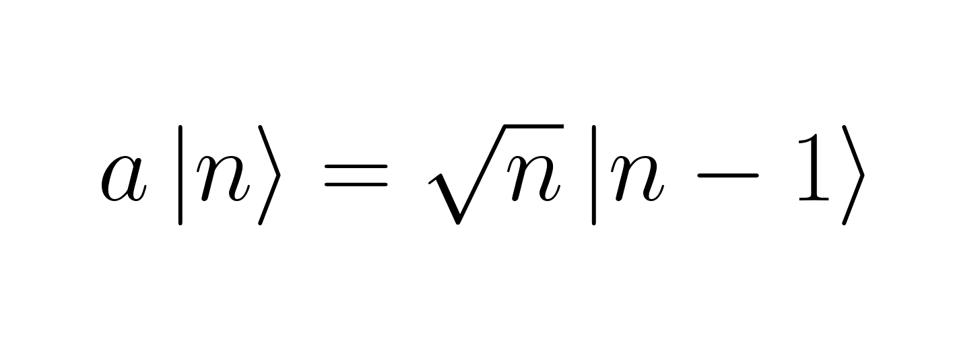
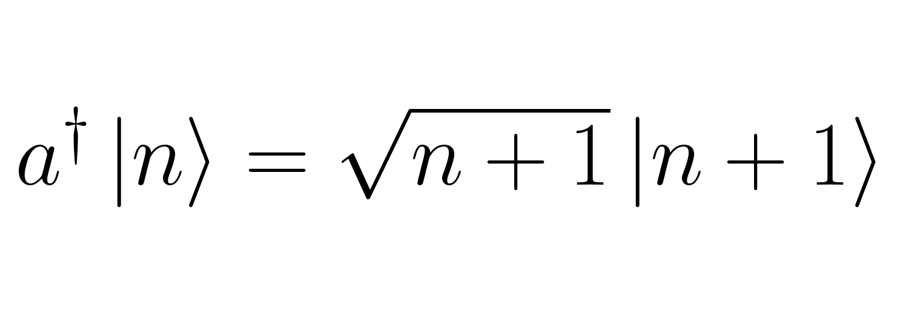
Digitisation - Harmonic Oscillator Basis _{[1]}
10
&
[1] - N. Klco and M. J. Savage, Digitization of scalar fields for quantum computing, Physical Review A
99, 10.1103/physreva.99.052335 (2019).

Slide 41
Digitisation - Harmonic Oscillator Basis _{[1]}
11
[1] - N. Klco and M. J. Savage, Digitization of scalar fields for quantum computing, Physical Review A
99, 10.1103/physreva.99.052335 (2019).

Slide 42
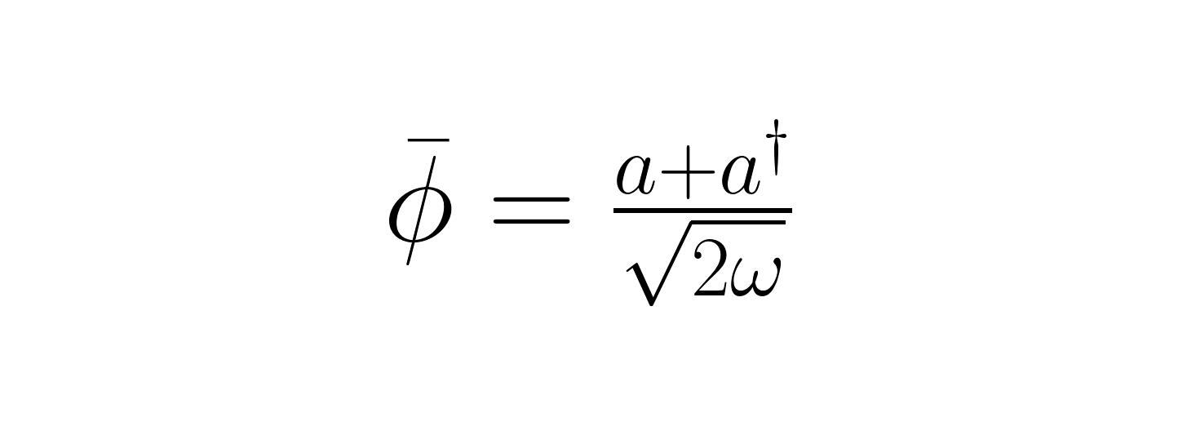
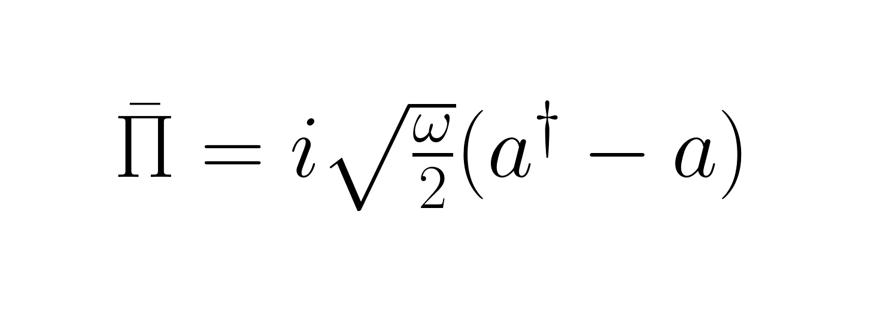
Digitisation - Harmonic Oscillator Basis _{[1]}
11
[1] - N. Klco and M. J. Savage, Digitization of scalar fields for quantum computing, Physical Review A
99, 10.1103/physreva.99.052335 (2019).

Slide 43
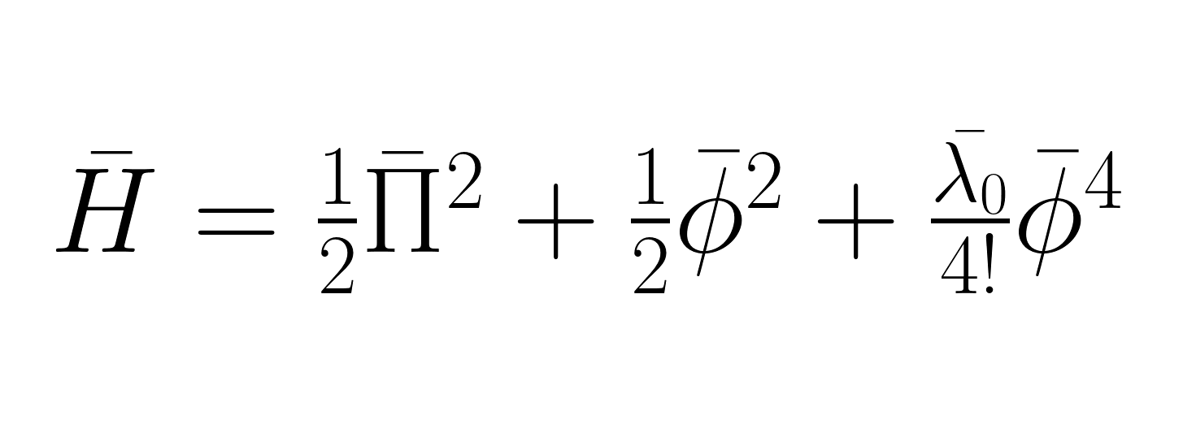
Digitisation - Harmonic Oscillator Basis _{[1]}
11
[1] - N. Klco and M. J. Savage, Digitization of scalar fields for quantum computing, Physical Review A
99, 10.1103/physreva.99.052335 (2019).

Slide 44
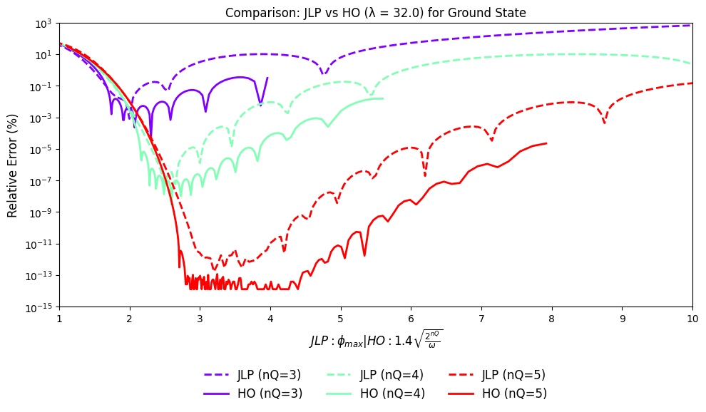
Digitisation - Harmonic Oscillator Basis
12
Harmonic Oscillator basis significantly outperform JLP at a given number of Qubits
Direct reproduction of structure seen in literature _{[1]}
[1] - N. Klco and M. J. Savage, Digitization of scalar fields for quantum computing, Physical Review A
99, 10.1103/physreva.99.052335 (2019).

Slide 45
Hamiltonian Truncation Effective Theory _{[2]} - Looking at improving Digitisation Methods
13
Can we reduce error further?
Can we reduce the qubit requirement for that error?
[2] - T. Cohen, K. Farnsworth, R. Houtz, and M. Luty, Hamiltonian truncation effective theory, SciPost Physics 13, 10.21468/scipostphys.13.2.011 (2022).

Slide 46
Hamiltonian Truncation Effective Theory _{[2]} - Looking at improving Digitisation Methods
13
Can we reduce error further?
Can we reduce the qubit requirement for that error?
HTET:
Seeks to incorporate part of truncated space back into the Hamiltonian
Create an effective Hamiltonian that approximates the contributions from the truncated space
[2] - T. Cohen, K. Farnsworth, R. Houtz, and M. Luty, Hamiltonian truncation effective theory, SciPost Physics 13, 10.21468/scipostphys.13.2.011 (2022).

Slide 47
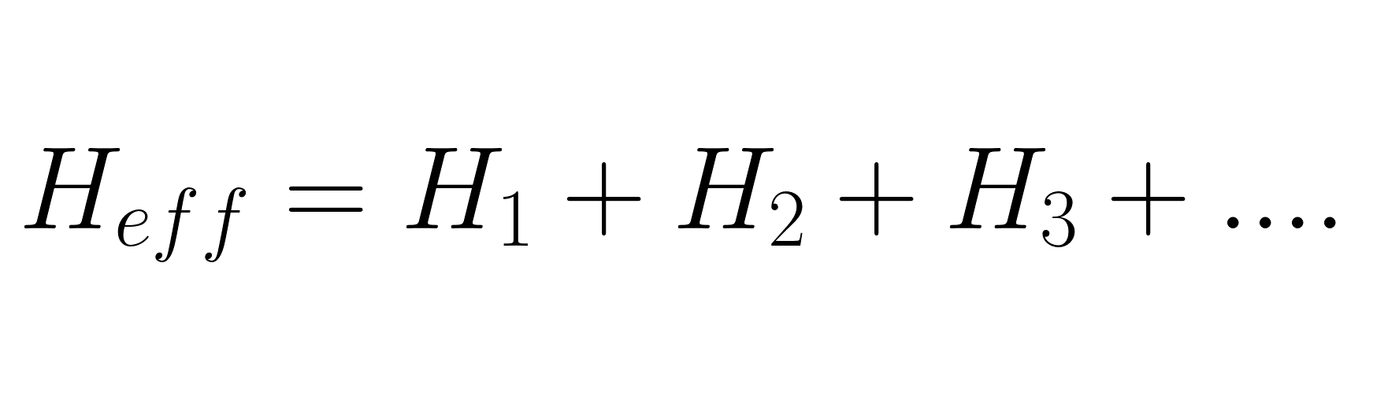
Hamiltonian Truncation Effective Theory _{[2]} - Looking at improving Digitisation Methods
13
Can we reduce error further?
Can we reduce the qubit requirement for that error?
HTET:
Seeks to incorporate part of truncated space back into the Hamiltonian
Create an effective Hamiltonian that approximates the contributions from the truncated space
[2] - T. Cohen, K. Farnsworth, R. Houtz, and M. Luty, Hamiltonian truncation effective theory, SciPost Physics 13, 10.21468/scipostphys.13.2.011 (2022).

Slide 48
Hamiltonian Truncation Effective Theory_{[2]} - What is it?
14
[2] - T. Cohen, K. Farnsworth, R. Houtz, and M. Luty, Hamiltonian truncation effective theory, SciPost Physics 13, 10.21468/scipostphys.13.2.011 (2022).

Slide 49
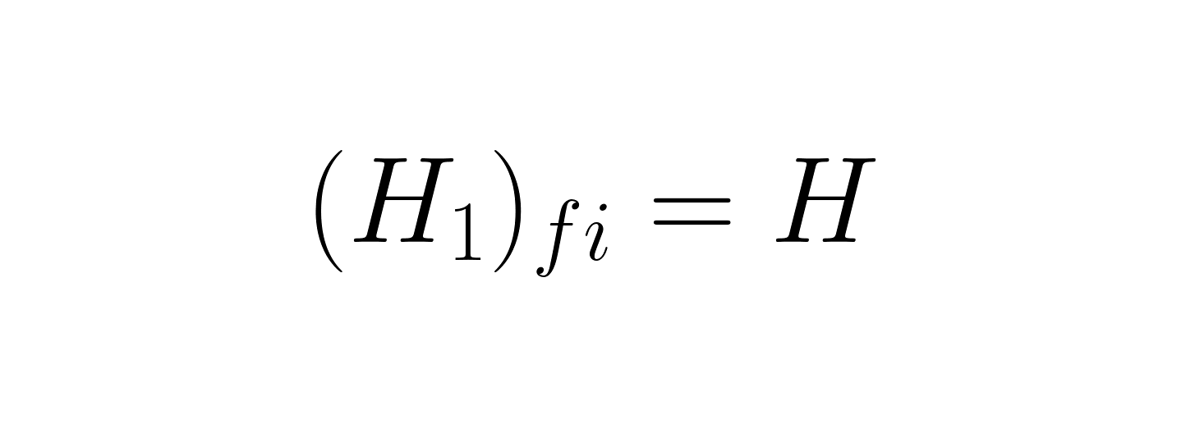
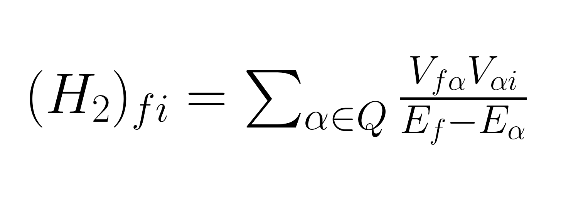
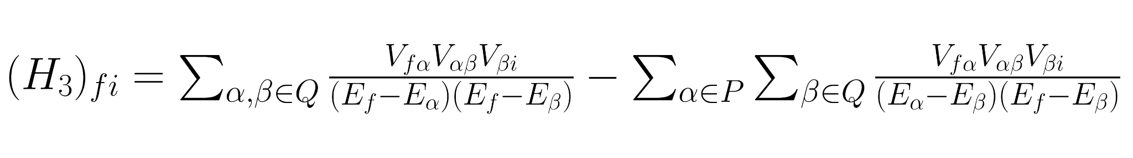
Hamiltonian Truncation Effective Theory_{[2]} - What is it?
14
P is the region below E_{max}, Q is the region above E_{max}
[2] - T. Cohen, K. Farnsworth, R. Houtz, and M. Luty, Hamiltonian truncation effective theory, SciPost Physics 13, 10.21468/scipostphys.13.2.011 (2022).

Slide 50
Hamiltonian Truncation Effective Theory_{[2]} - What is it?
14
Significantly H_{eff} is Non Hermitian This is justified for several reason in [2]:
The underlying full Hamiltonian is Hermitian
At physical eigenvalues the effective Hamiltonian reproduces the exact spectrum of the Hermitian Hamiltonian
Asymmetry that causes Non Hermiticity vanishes as E_{max} tends to infinity
P is the region below E_{max}, Q is the region above E_{max}
[2] - T. Cohen, K. Farnsworth, R. Houtz, and M. Luty, Hamiltonian truncation effective theory, SciPost Physics 13, 10.21468/scipostphys.13.2.011 (2022).

Slide 51
Hamiltonian Truncation Effective Theory_{[2]} - What is it?
15
[2] - T. Cohen, K. Farnsworth, R. Houtz, and M. Luty, Hamiltonian truncation effective theory, SciPost Physics 13, 10.21468/scipostphys.13.2.011 (2022).

Slide 52
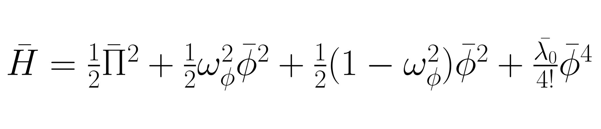
Hamiltonian Truncation Effective Theory_{[2]} - What is it?
15
[2] - T. Cohen, K. Farnsworth, R. Houtz, and M. Luty, Hamiltonian truncation effective theory, SciPost Physics 13, 10.21468/scipostphys.13.2.011 (2022).

Slide 53
Hamiltonian Truncation Effective Theory_{[2]} - What is it?
15
Why we introduce ω here:
At finite E_{max} results depend on basis choice, by varying ω we can optimise convergence and minimise truncation error (this is the same as the ω in HO basis)
Allows us to define H₀ + V_{residual}
We also set λ₀ = 1
[2] - T. Cohen, K. Farnsworth, R. Houtz, and M. Luty, Hamiltonian truncation effective theory, SciPost Physics 13, 10.21468/scipostphys.13.2.011 (2022).

Slide 54
Hamiltonian Truncation Effective Theory - What is it?
15
Potential (V)
Why we introduce ω here:
At finite E_{max} results depend on basis choice, by varying ω we can optimise convergence and minimise truncation error (this is the same as the ω in HO basis)
Allows us to define H₀ + V_{residual}
We also set λ₀ = 1
[2] - T. Cohen, K. Farnsworth, R. Houtz, and M. Luty, Hamiltonian truncation effective theory, SciPost Physics 13, 10.21468/scipostphys.13.2.011 (2022).

Slide 55
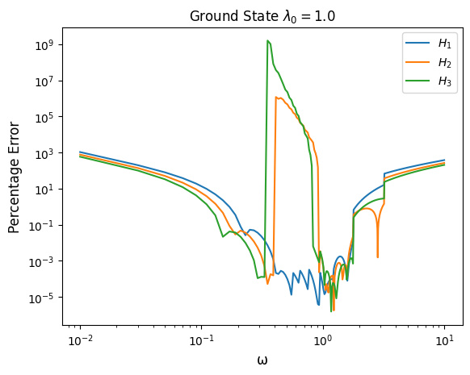
Hamiltonian Truncation Effective Theory
16
- Large errors at a critical E_{max} as denominators become small
- H1 mimics structure seen in _{[1]}
[1] - N. Klco and M. J. Savage, Digitization of scalar fields for quantum computing, Physical Review A
99, 10.1103/physreva.99.052335 (2019).

Slide 56
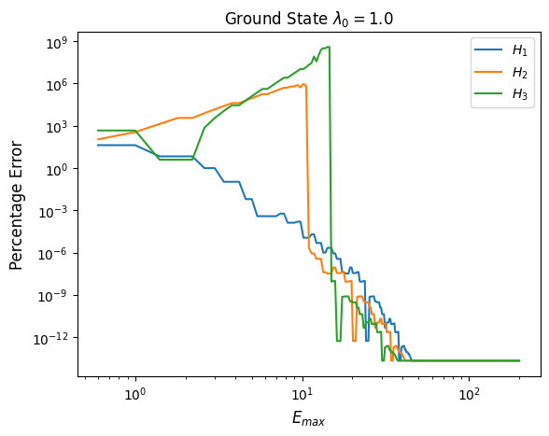
Hamiltonian Truncation Effective Theory
16
- Large errors at small E_{max} as denominators become small as E_{Q} -> E_{f} - H3 achieves a minimum error at a lower number of qubits than H2 than H1 - Agreement with literature_{[3]} that HTET is viable for NISQ era devices
 | E_{max} at minimum error
H1 | 38.16
H2 | 34.17
H3 | 30.17
[3] - S. Williams, Simulating quantum field theories on near-term quantum devices, International
Journal of Modern Physics A 40, 26 (2025).

Slide 57
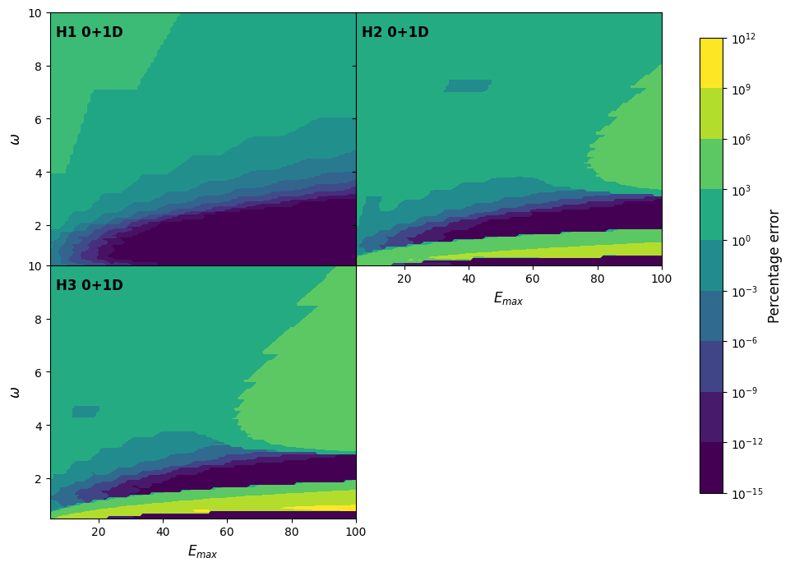
Hamiltonian Truncation Effective Theory
17
General expected structure from previous two graphs
H3 achieves a minimum error at a lower number of qubits than H2 than H1
Lowest values of error depend on choice of ω
 | E_{max} at minimum error
H1 | 37.31
H2 | 33.42
H3 | 29.86

Slide 58
Goal: Determine whether Hamiltonian Truncation Effective Theory can reduce digitisation errors and/or qubit requirements compared to basic JLP and HO basis methods in 0+1D scalar field theory
We looked at:
What digitisation is
Methods of digitisation
Which of JLP or HO basis had reduced errors
What Hamiltonian Truncation Effective Theory is
Can it be effective in reducing the errors of digitisation
18
HTET can reduce digitisation and/or qubit requirements within 0+1D compared to digitisation methods provided you are able to correctly tune ω

